Slide 1





Data-Driven Network Path
Simulation with iBox
Sachin Ashok¹
University of Illinois at Urbana-Champaign
Shubham Tiwari
Nagarajan Natarajan
Venkat Padmanabhan
Sundararajan Sellamanickam
Microsoft Research India
¹ Work done while at MSR
Notes:
Hello everyone, welcome to my presentation.
I'm Sachin Ashok, a 2nd year graduate student at University of Illinois at Urbana-Champaign. Today, I'll be presenting iBox which is a data-driven network path simulator.
This is joint work with my colleagues at Microsoft Research India: Shubham, Nagarajan, Venkat and Sundararajan.

Slide 2




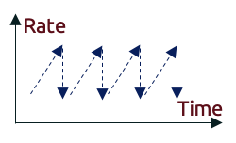
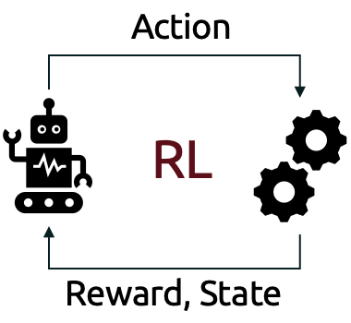


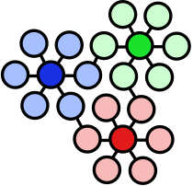

Motivation
Networked applications need to be tested in real-world conditions
  Real-time, interactive streaming: MS Teams, Zoom, …
  On-demand streaming: Netflix, YouTube, …
  Congestion control, jitter buffer tuning, codecs, …
Testbeds often lack the scale and reach to be representative
  E.g., PlanetLab (Princeton), Pantheon (Stanford), PeerMetric (MSR), Emulab (Utah)
So, flighting to real users is the norm, but…
  It tends to be expensive and potentially disruptive
  Particularly time-consuming for ML-based training/tuning
Is network simulation the answer?
Notes:
(Next) The motivation for our problem is rooted in the observation that most networked applications need to be tested in real-world conditions in order to achieve good performance
(Next) For example, real time interactive streaming apps like Teams or Zoom.
(Next) On demand streaming like Netflix
(Next) or for tuning parameters for congestion control or video codecs.
(Next) At the same time, network testbeds like PlanetLab or Pantheon often lack the scale and reach to the representative of real-world networks.
(Next) So usually flighting new features to real users in a production setting is the norm
(Next) But this tends to be quite expensive as well as potentially disruptive as new features can introduce performance regressions
(Next) Flighting is also particularly time-consuming if you need to use ML based training which usually requires thousands of iterations to converge as each iteration would take a long time in a production setting.
(Next) So then is network simulation the answer to our problem?
Note: Put A/B testing in brackets

Slide 3
Current state of network simulation
Discrete-event simulation
String together network of
simulated components
e.g., ns-2/3, NetEm, OPNET
Trace-driven replay
Replay real-world traces
e.g., Cellsim/Mahimahi
Calibrated simulators
Learn network parameters
e.g., Pantheon
Can we do better?
Provides realistic behavior at component level …
Informed by data …
Learns values for network parameters …
… but not informed by data!
… but not realistic as it does not account for impact of a new, different sender under test
… but does not model crucial network phenomena like cross-traffic
Notes:
So, let's look at what's possible with network simulation
There are three broad kinds
(Next) The first is discrete-event simulation where we string together a network of simulated components like buffers and links like in NS-3 or NetEm
(Next) This obviously provides a realistic behavior at a component level
(Next) but it isn't quite informed by data as we don't know how to set realistic parameters for our simulation
(Next) Now the second kind is trace-driven replay where real-world traces are replayed during simulation. For example, like in Cellsim or Mahimahi.
(Next) Although these simulations are obviously informed by data, (Next) they are not realistic as they do not account for the impact caused by a new different sender under test.
(Next) Finally, there's some recent work on calibrating simulators for example like in Pantheon (Next) which tries to learn values for network parameters, (Next) but it does not model crucial network phenomena like cross-traffic.
(Next) So the question is can we do better?

Slide 4

Introducing “Internet in a Box”
Speed and convenience of a simulator
iBox
Realism of real-world networks
Overview
  iBox is a network path simulator which learns from real-world data and recreates realistic end-to-end network behaviour of a target network path
Notes:
This is where iBox comes in. iBox stands for internet in a box.
(Next) We take the speed and convenience of a simulator and (Next) combine it with the realism of real-world networks (Next) to get iBox
(Next) At the heart of it, iBox is a network path simulator which learns from real-world data and recreates realistic end-to-end network behavior of a target network.
Note: Have a goals slide

Slide 5

Introducing “Internet in a Box”
Real apps (e.g., TCP bulk sender) provided by users
iBox only provides a substitute for the network
Test a sender/protocol on path S → R
Build model for S → R
Learning from real world
S
Internet in a Box
R
packet time series at S
(i₁ = (t₁, s₁), i₂, i₃, …)
R
Network Model Training
iBox Network Path
Simulator/Emulator
iBox Network
Models
S
packet time series at R
(o₁ = (r₁, d₁),o₂,o₃,…)
Training Phase
Testing Phase
Sampled iBox Network Model
Draw sample and configure iBox
iBox Model Repository
Notes:
At a very high level, this is how it works
(Next) Let's say you have a network path through the internet between a sender S and a receiver R
(Next) We collect traces from this path in the form of input/output packet traces. The input corresponds to packet sent timestamps and the packet sizes and the output corresponds to the receive timestamps and the corresponding delay that each packet faced.
(Next) These traces are used for network model training, and (Next) this is the training phase.
(Next) We generate one model per network path and these network models are aggregated within the iBox model repository.
(Next) Now to run simulations, we sample a iBox network model from the repository and (Next) configure the simulator.
(Next) And to test a new protocol on this learnt path from S to R, (Next) we pass the packets from the sender via the iBox simulator, delay or drop packets within the simulator and (Next) pass the output to the receiver and (Next) this is our testing phase.
(Next) And just to be clear, S and R here are real apps that are provided by the users of iBox. iBox only provides a substitute for the network.

Slide 6


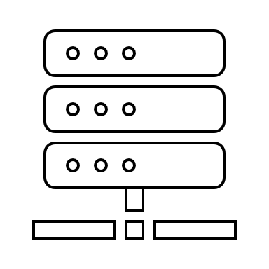








Promising use-case: A/B testing
Version B
logs
Version B
Version A
Version A
Version A
Version A
Version A
Slow
Risky
Expensive
Process logs
Compare A and B
Fine-tune version B
Internet
New Feature
Version B
logs
Notes:
One of the most promising use-cases for this work is to help in A/B testing of a product.
Imagine this scenario where you have a production system serving many clients.
In A/B testing, when developers implement a new feature, (Next) they roll it out to small percentage of (Next) clients like version B as shown here.
(Next) Once it is operational, they collect traces corresponding to version B (Next) from both the client (Next) as well as the service
(Next, Next) They process these logs, (Next) compare the performance of A and B and (Next) fine-tune B based off their observations. In cases where B works well, they might roll it out to all users.
But there are many problems with this approach. (Next) First is that it's quite slow because iterations take too long in production, (Next) second it is risky as version B could contain bugs which would result in bad service, and (Next) finally, it is expensive since bad service and performance regressions can cause customers to drop their product altogether.
Note: don't spend too much time here

Slide 7



Promising use-case: A/B testing
Version B
logs
Version B
Version A
Version A
Version A
Version A
Version A
Fast
Safe
Cheap
Process logs
Compare A and B
Fine-tune version B
iBox
Internet
New Feature
Version B
logs
Test clients
Notes:
Now instead if a realistic simulator like iBox was available, (Next) it could replace the real internet with a simulator and when (Next) developers implement a new feature, they test it by running it against the iBox simulator to (Next) which simulated test clients are connected and just like before, they can (Next) collect the logs from both the simulated client (Next) and the service.
Now, (Next) like in the previous scenario, (Next) they process these logs, (Next) compare A and B, and (Next) fine-tune B.
This would enable the feature development cycle to be (Next) fast since we're using simulations, (Next) safe from regressions as iBox is able to detect regressions before they go to production as well as (Next) cheap as customers are not exposed to defective features.

Slide 8


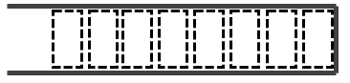
iBox: Internet in a Box
Static parameters: B, b, d
Use a simplified model to capture key characteristics of the network path b/w sender and receiver
Wide area network
B (buffer size)
b (bottleneck bandwidth)
d (propagation delay)
Sender
Receiver
Notes:
So let's dive a little more deeper into how iBox is designed.
First, we use a simplified model to capture key characteristics of the network path b/w sender and receiver.
(Next) So, let's imagine a sender and receiver communicating through a (Next) wide area network path.
(Next) We model this path as a single bottleneck consisting of link with a (Next) buffer with size B, (Next) bottleneck supporting a bandwidth of small b and (Next) the path itself imposing a propagation delay of duration d.
(Next) These three parameters B, small b and d are the static parameters of the initial simplified model.
XXX
At the end we just say that we will shortly see why it is imperative to model cross-traffic.
Also, we’re only interested in modeling the bottleneck
Explanations
1. Buffer size: cubic can estimate max buffer very well since it fills up buffers
2. Bottleneck bandwidth: depends on other flows
3. Prop delay: depends on min buffer
a. Cubic is explorative
b. We look at multiple traces from the same path
c. Basic estimates and we build on top of this

Slide 9
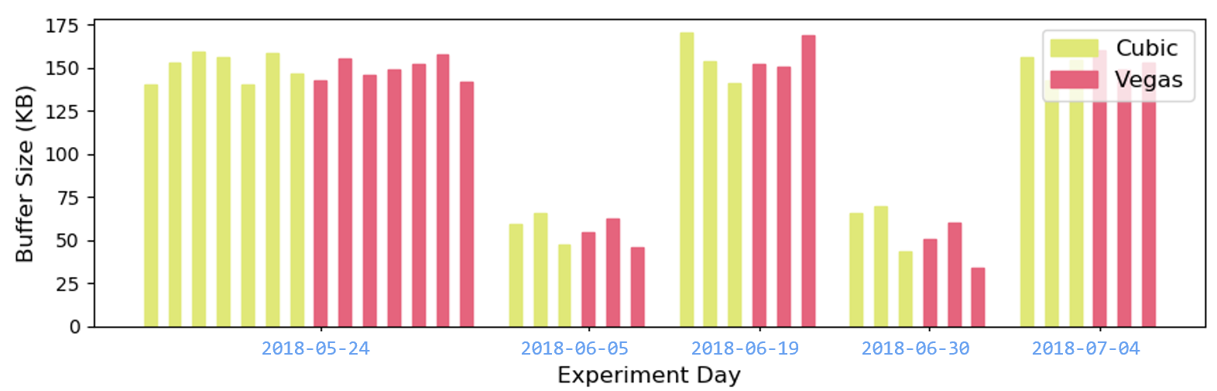
iBox: Static Parameters
Estimation of static parameters:
  b (bottleneck bandwidth) based on peak receiving rate seen in the trace
  d (propagation delay) based on minimum delay experienced by packets in the trace
  B (buffer size) based on b and the difference between the min and max delays (max queueing delay)
Online vs offline estimation
  Online: Estimates improve as more observations are made (e.g., in congestion control)
  Offline (our scenario): Entire trace is available offline, so estimates benefit from entire set of observations
We also combine information from multiple flows on same day to get better estimates
Notes:
(Next) At a high level, the static parameters are estimated as follows
(Next) The bottleneck bandwidth b is based off the peak receiving rate seen in the trace.
(Next) The propagation delay d is based on the minimum delay experienced by packets in the trace
(Next) And the buffer size B is based on the bottleneck bandwidth and the difference between the min and the max delay faced by packets in the trace which corresponds to the maximum queuing delay a packet can face
(Next) Also, please note, that this is quite different from online estimation.
(Next) In online estimation, estimates improve over time as more observations are made. For example, in the case of a congestion controller estimating available bandwidth.
(Next) Whereas in our scenario which is the offline case, the entire trace is available offline so our estimates can benefit from the entire set of observations.
(Next) Additionally, we can also combine information from multiple flows on the same day to get better estimates.
(Next) For example, in this plot, the estimated buffer size is shown on the y axis and dates corresponding to the traces are shown on the x axis. (Next) We can combine information from multiple traces from the same day to get a better estimate for buffer size
XXX
At the end we just say that we will shortly see why it is imperative to model cross-traffic.
Explanations
1. Buffer size: cubic can estimate max buffer very well since it fills up buffers
2. Bottleneck bandwidth: depends on other flows
3. Prop delay: depends on min buffer
a. Cubic is explorative
b. We look at multiple traces from the same path
c. Basic estimates and we build on top of this

Slide 10
iBox: Dynamic Parameters
Model cross traffic via a single parameter C
C (cross traffic)
Wide area network
B (buffer size)
b (bottleneck bandwidth)
d (propagation delay)
Sender
Receiver
Notes:
Now let's look at the dynamic parameters that iBox estimates.
The model from before is (Next) too simplified as it does not account for cross traffic.
(Next) So next, we model cross traffic via a single parameter called C.

Slide 11
iBox: Dynamic Parameters
Model cross traffic via a single parameter C
Estimating cross-traffic (C) as a static rate time series → Non-Reactive Cross Traffic (NRCT)
C (cross traffic)
Wide area network
B (buffer size)
Q(k) = queue occupancy estimated at the kth packet
C_{est} = (estimate of) cross traffic
∑si: Sum of all packet sizes in window
drainTime: Duration for which buffer was draining at bottleneck bandwidth
b: Bottleneck bandwidth
∑τi: Sum of all inter packet times in window
Q(k)
Q(k - n)
b (bottleneck bandwidth)
Self traffic
Q(k) – Q(k - n)
∑τ_{i}
d (propagation delay)
{
=
C_{est}
+
∑s_{i}
–
}
Sender
drainTime
*
b
/
Receiver
Notes:
(Next) In our first iteration of estimating cross-traffic, we estimate it as a static rate time series which we call non-reactive cross traffic.
(Next) So, let's see how we can estimate it. (Next) Let me clear up this diagram.
(Next) Our estimation in a nutshell benefits from the observation that a buffer is governed by three phenomena: packets entering the buffer due to our self traffic, packets entering the buffer due to cross traffic and then packets draining from the buffer at the allocated bandwidth.
(Next) First, we take two observations of the delay faced by the kth and (k-n)th packet which corresponds to Q(k) and Q(k-n).
(Next) As I said before the difference between these two quantities should be explained by 3 factors: (Next) cross traffic packets entering the buffer which is C, (Next) our packets entering the buffer which is sum over Si and (Next) finally packets leaving the buffer due to the link draining which is denoted as drainTime into b.
Now since we know how many packets we've put in and we have earlier estimated the rate at which this queue drains, (Next) we can simply re-arrange the terms in this equation to calculate the amount of bytes cross traffic must have sent into this buffer in this duration.
(Next) We then divide by the time gap between our observations to get the estimate of the rate of cross traffic.
Now this estimate shown here is just a single value. For an entire trace, we would have many many pairs of packets on which we run this estimate in a sliding window manner which gives us a time series of the rate of cross traffic.
Note: High level overview about drainTime and explain that it's explained in the paper

Slide 12
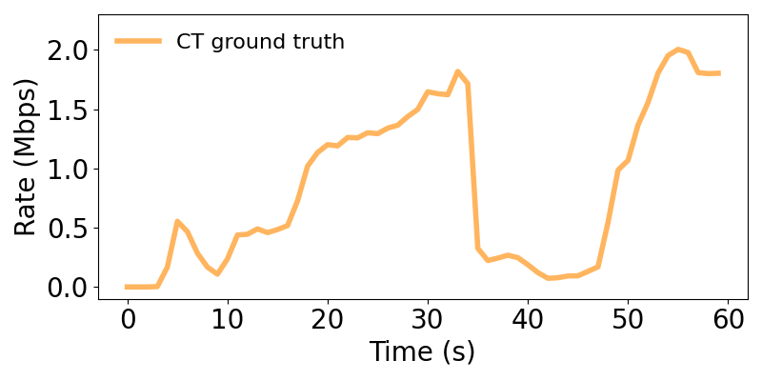
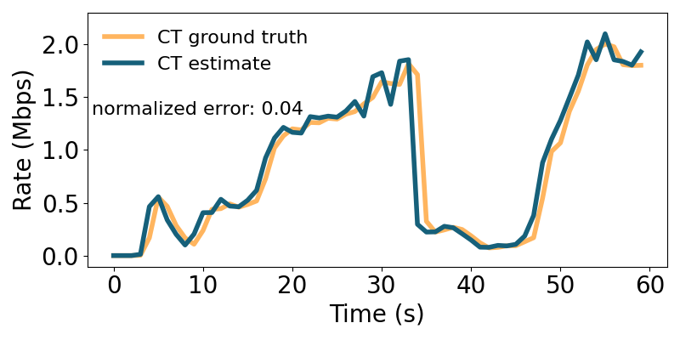
Non-Reactive Cross Traffic (NRCT)
How well does it work?
Here’s an example … (aggregate results later)
Notes:
So how well does this work?
(Next) Here's an example from simulation.
What you see here is the ground truth of the cross traffic that was recorded. On the x axis you have time and on the y axis you have rate.
(Next) We run the process mentioned before and the blue curve is the estimate that we get.
We can see that the estimate very closely matches the ground truth and therefore can be used to replay realistic cross traffic patterns in simulation.

Slide 13
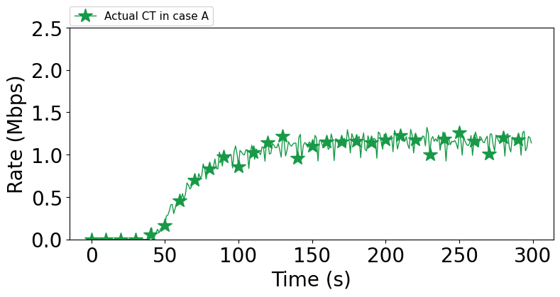
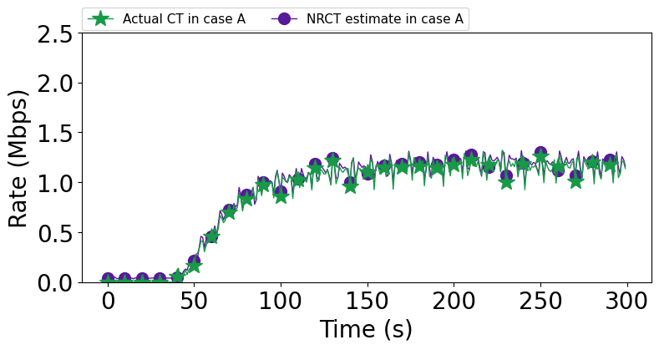
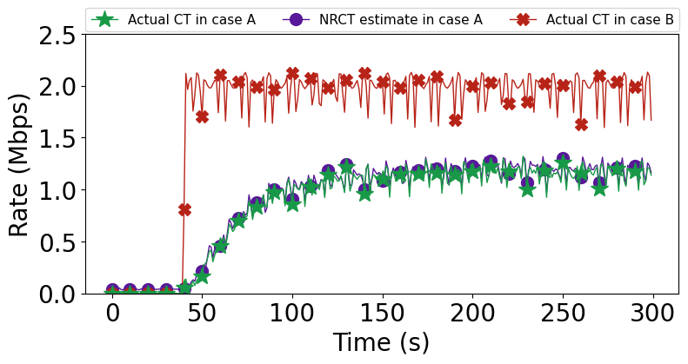
NRCT limitation
But is “non-reactive” cross-traffic which is replay of cross traffic packets good enough?
Scenario A
Self traffic: TCP Cubic (aggressive)
Cross traffic: TCP Cubic (aggressive)
Scenario B
Self traffic: LEDBAT (timid)
Cross traffic: TCP Cubic (aggressive)
GT cross-traffic when LEDBAT is the observation flow
Note the disparity!
Cross traffic can “react” differently to different kinds of competing traffic which static replay cannot capture!
Estimated cross-traffic when Cubic is the observation flow
Note the match!
GT cross-traffic when Cubic is the observation flow
Notes:
(Next) But is non-reactive cross-traffic which is basically just a replay of cross-traffic packets good enough?
Let's see an experiment which highlights a problem.
(Next) Imagine scenario A where you have our sender which uses TCP Cubic which is an aggressive congestion control protocol. The cross-traffic it competes with is also TCP Cubic and hence similarly aggressive.
(Next) This is what the ground truth cross traffic measured in scenario A looked like.
(Next) Now when we apply our NRCT estimation formula, we get the following estimate for cross traffic. (Next) Note that the match is almost perfect.
(Next) Now in scenario B, we change our protocol from Cubic to something more timid like LEDBAT which gives up bandwidth if there is any competition on the link. We keep the cross traffic the same and similarly aggressive as in scenario A.
The ground truth of cross traffic when LEDBAT is used as the self flow is (Next) shown by the red line. As you can see, the cross-traffic ramps up and gets more share of the bottleneck bandwidth. (Next) And quite clearly there's a big disparity between our previous estimate and the cross traffic ground truth in this scenario. This is because in the second case, the cross traffic reacted to the fact that our flow was more timid and backed off from competition on the link.
(Next) What this means is that cross traffic can react differently to different kinds of competing traffic which static replay cannot capture.
Note: limitation of NRCT

Slide 14

Reactive Cross Traffic (RCT)
Model cross-traffic as a set of reactive TCP flows → Reactive Cross Traffic (RCT)
Overall Cross Traffic
Constituent flows
Static NRCT estimate time series
<3.6 mbps, t = 0s>
<4.5 mbps, t = 1s>
…
List of Reactive TCP flows
<Cubic, start: 3s, end: 10s>
<Vegas, start: 5s, end: 15s>
…
Rate
Rate
1
Time
Use Bayesian Optimization-based search to search for the type, start and stop times of these flows
Rate
2
Time
Time
Notes:
(Next) So in order to make our cross traffic reactive, we model cross traffic as a set of real, reactive TCP flows which we call reactive cross traffic or RCT.
(Next) So for example, let's say you have this aggregate volume of the overall cross traffic, what we try to do is break it down into its individual constituent flows
(Next) So instead of a static time series, it would look something like this where our model basically tries to learn how many cross-traffic flows there are, what the nature of these flows are, for example are they running cubic or vegas, and also when these flows start and stop.
Here in this example, the cross traffic consists of two flows, one running Cubic which starts at 3s and ends at 10s and the other runs vegas which starts at 5 and ends at 15 seconds.
(Next) Finally, instead of using any sophisticated formulation, we use a bayesian optimization-based search to search for these parameters. I will briefly talk about this search process next.

Slide 15




Reactive Cross Traffic (RCT)
Parse raw trace file
Configure simulator with basic network parameters and selected cross-traffic parameters
5
ns-2/3 or NetEm
simulation
Example RCT parameters outputted by the search:
1
Estimate basic network parameters
Cross-traffic parameter selection via
Bayesian Approach
[
{
"type": "cubic",
"start": 15,
"stop": 29
},
{
"type": "cubic",
"start": 4,
"stop": 5
},
{
"type": "cubic",
"start": 0,
"stop": 5
}
]
Estimated
NRCT
6
2
Search process
Evaluate traces
Estimate cross-traffic through NRCT model
Disparity?
4
3
7
8
Time
Use NRCT model as seed to initialize the RCT model computation
If loss is too high,
iterate
If loss is low,
output RCT parameters
Notes:
So the algorithm for computing RCT is as follows:
Click 1: we take a raw trace file and parse it,
Click 2: we use the processed trace file to estimate basic network parameters like bottleneck bandwidth, propd and buffersize,
Click 3: we then estimate cross-traffic through NRCT model.
Click 4: and use the NRCT model as seed for initializing the RCT model computation
What I mean by that is that we analyse the NRCT estimate using a change point detection algorithm to find points where massive changes occurred to find good starting points to seed our search for RCT parameters.
Click 5: for each iteration of RCT model computation, we use a bayesian approach to select the next set of cross-traffic parameters. In the very first iteration, it would just be the seed values.
Click 6: we then use these cross-traffic parameters along with the basic parameters to run a simulation
Click 7: Now once we have the trace from simulation, we compute the disparity w.r.t to ground truth
Click 8: if the disparity is too high, then we continue the iterations
Click 9: if the disparity is low enough, we exit and output the RCT parameters.
Click 10: The search process essentially keeps running until we find good RCT parameters
Click 11 + 12: Here is an example of an RCT configuration obtained via this approach:
the configuration specifies 3 flows, all cubic which start and stop at different times

Slide 16
iBox Pipeline
Build model for S → R
Test a sender/protocol on path S → R
Learning from real world
S
Internet in a Box
R
packet time series at S
(i₁ = (t₁, s₁), i₂, i₃, …)
R
Network Model Training
iBox Network Path
Simulator/Emulator
iBox Network
Models
C (RCT)
B
b
S
packet time series at R
(o₁,o₂,o₃,…)
d
Training Phase
Testing Phase
Sampled iBox Network Model
Draw sample and configure iBox
iBox Model Repository
Notes:
Now finally, putting this all together, it should be clear that the iBox model we introduced in the beginning is (Next) basically a simulator parameterized by network parameters like Bottleneck bandwidth, buffer size, propagation delay and crucially the reactive cross traffic.
Now that I've introduced iBox and talked extensively about its design, I shall be handing over to my collaborator Shubham to talk more about the implementation and the overall evaluation of iBox.

Slide 17
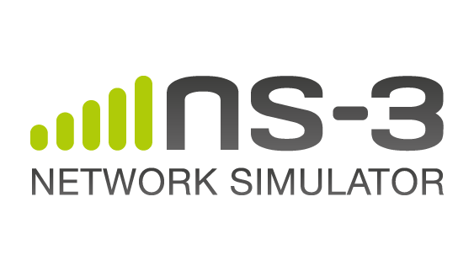

Evaluation Setup
Given an iBox model (static parameters and cross-traffic), how does one test a new sender/protocol?
Cross-Traffic
C
Bandwidth
Link delay
Buffer size
C
S_{C}
R_{C}
NetEm
C
C
X
Y
Simulated link
C
X
Y
C
S
R
Deploy sender/protocol
to test
Notes:
Hello everyone.
I’m Shubham. I am a Research Fellow at Microsoft Research India. I will be talking about evaluation of iBox.
(Click)
Now that we are given static parameters and cross-traffic, how do we test a given sender/protocol? (click) We setup a simple dumbbell topology and set the static parameters (click), on the bottleneck link. We send cross-traffic (click) through node Cs to Cr across the bottleneck link (click) (click) The sender under test is deployed at node S and the corresponding receiver is deployed at node R. We implement this topology using popular simulation/emulation frameworks such as ns2 (click), ns3 (click) and netem (click).

Slide 18
Evaluation Outline
Static Parameters
Non-Reactive Cross Traffic (NRCT)
Reactive Cross Traffic (RCT)
Overall evaluation
Notes:
In our paper, we evaluate the accuracy of static parameters, NRCT and RCT models. Putting static parameters and cross-traffic model together, we present an overall evaluation that shows how well iBox predicts performance of network protocols on real world network paths.
(click)
In this talk, my focus will be on NRCT and overall evaluation

Slide 19

Evaluation Dataset
USA
India
Traces: 241
Traces: 412
Mexico
Traces: 150
Nepal
Pantheon Testbed*
Period: 1-2 years
Protocols: Cubic, Vegas, BBR
Network types: Ethernet, Cellular, WiFi
Locations: USA, Mexico, Colombia, India, Nepal, China
Traces: 86
China
Traces: 300
Colombia
Traces: 150
*Francis Y. Yan et.al, Pantheon: the training ground for Internet congestion-control research
Notes:
The evaluation dataset consists of real-world traces from a diverse set of geographical locations, like India , China, Nepal and so on…
(click)
The traces were collected over a period of 1-2 years and correspond to a variety of protocols like Cubic, Vegas and BBR,
Also, the traces were collected over various link types like ethernet, cellular and wifi.

Slide 20
Evaluation: NRCT
Two scenarios:
  Controlled setting
  Real world setting
Notes:
Coming to NRCT, we evaluate NRCT in a (click) (click) controlled setting as well as in a (click) real world setting. In the controlled setting, we evaluate NRCT on traces generated using an emulator. In the real world setting, we evaluate NRCT on traces collected on real world networks.

Slide 21
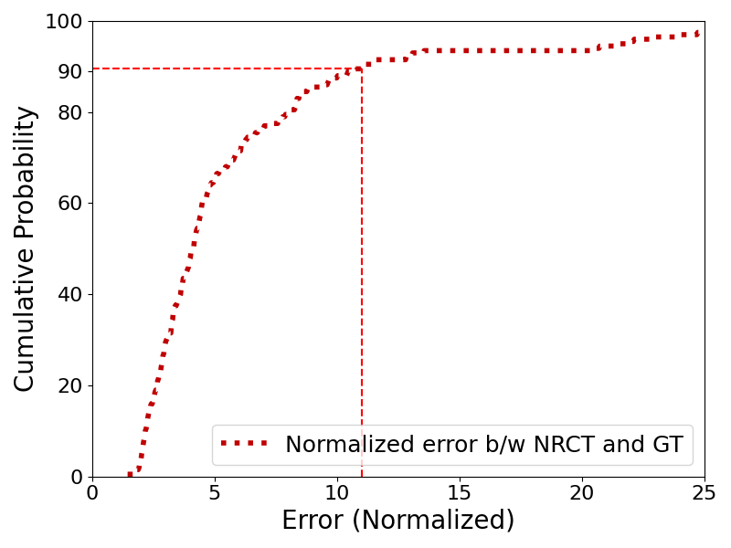
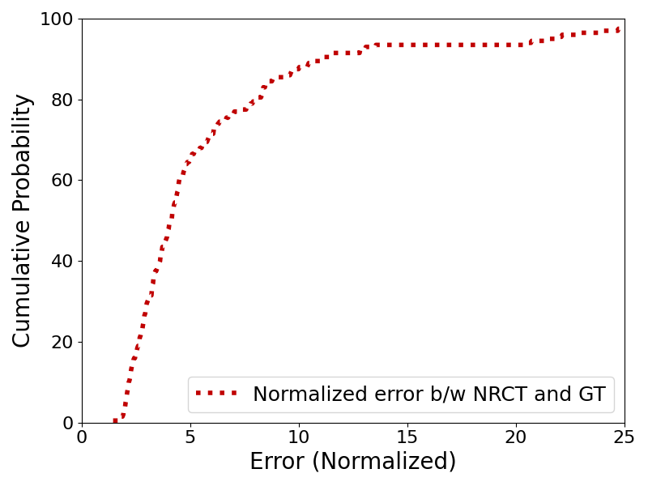
Evaluation: NRCT (controlled)
Notes:
In the controlled setting we generate Ground-Truth traces by randomly sampling a set of TCP flows and playing them on a simulator alongside an observation flow.
We then compute an estimate of the NRCT using only the observation flow as described by Sachin and compare it with the known GT cross-traffic.
Here an example that compares NRCT estimate with its Ground-Truth. In this example, the estimate is within 4% of the GT cross-traffic.
(click)
The plot on the right shows the CDF over several runs of the error between the NRCT estimate and GT.
(click)
The 90th percentile error is 11% suggesting a close match between the NRCT estimate and GT.

Slide 22
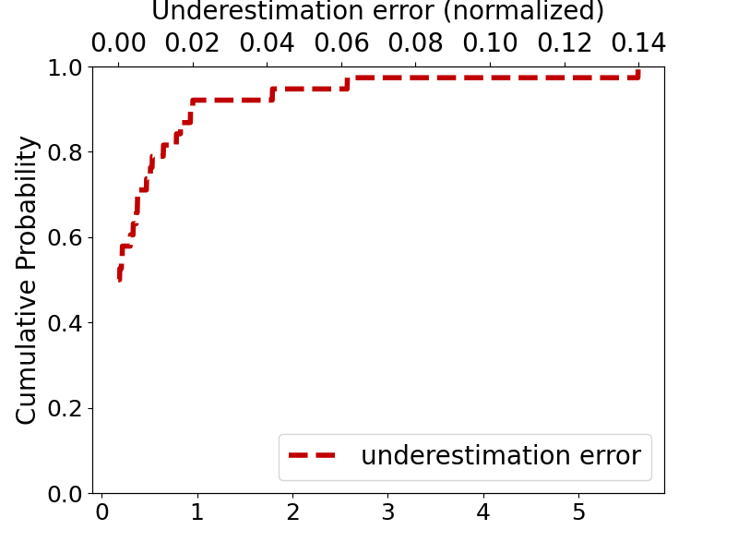
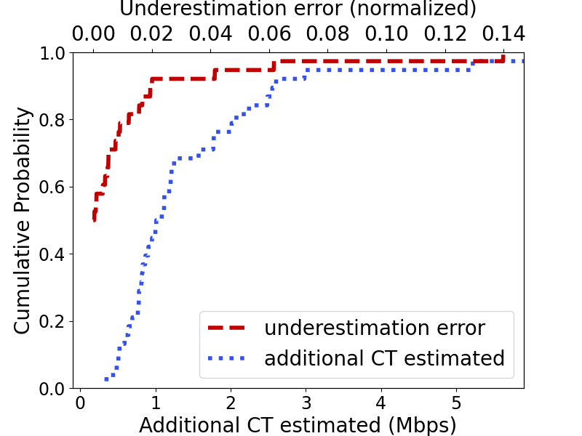
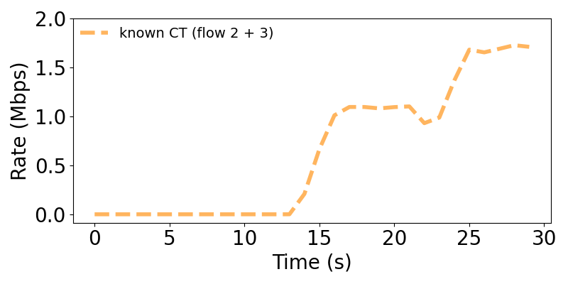
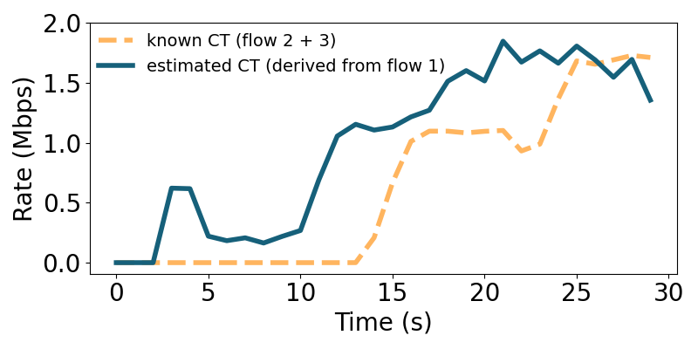
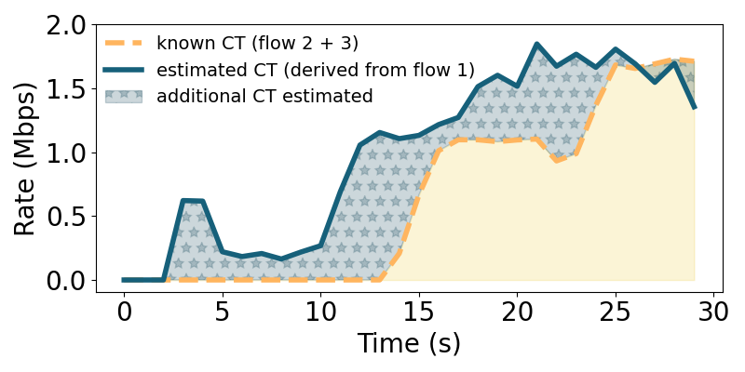
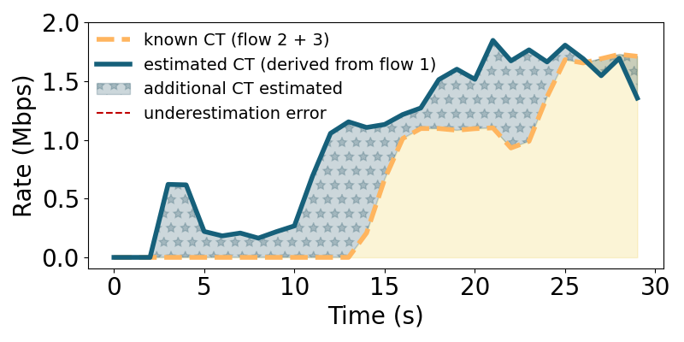
Evaluation: NRCT (real world)
Metrics:
  Underestimation error (lower bound violation error)
  Additional CT estimated (cross-traffic rate exceed beyond lower bound)
Notes:
In traces coming from real world networks, the GT cross-traffic is not observed making it tough to evaluate NRCT in a real world setting.
One idea is to is to run concurrent connections on a real network path, pick one flow as the observation flow and treat rest as the cross-traffic flow.
(click)
We use two evaluation metrics: (click) the underestimation error and (click) additional CT estimated. Lets take an example to understand these metrics. (click) We choose a trace with 3 concurrent flows and pick flow 1 as the observed flow and flows 2 and 3 as the CT flows. The yellow curve in the plot shows the known ct. (click) The blue curve shows the NRCT estimated using the observed flow 1. The addition cross-traffic estimated is the volume of cross-traffic estimate that exceeds the known lower bound (click) (which is shown as blue dotted area in the plot). (click) The region where the NRCT estimate violates the known lower bound is marked by the red dotted line. Such regions represent the underestimation error.
(click)
The plot on the right, shows the CDF of underestimation error. The underestimation error is quite small, that is under 2% in over 90% of the cases. The additional CT is under 250% in 90% of the cases.

Slide 23
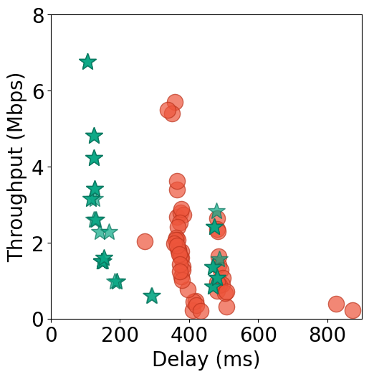
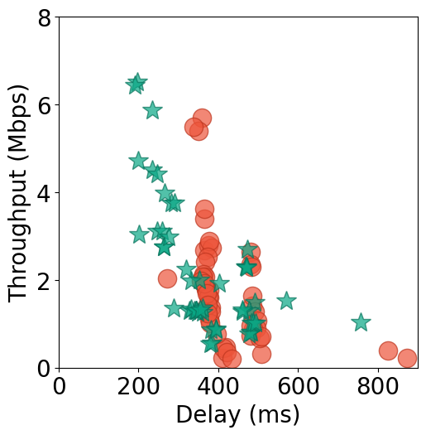
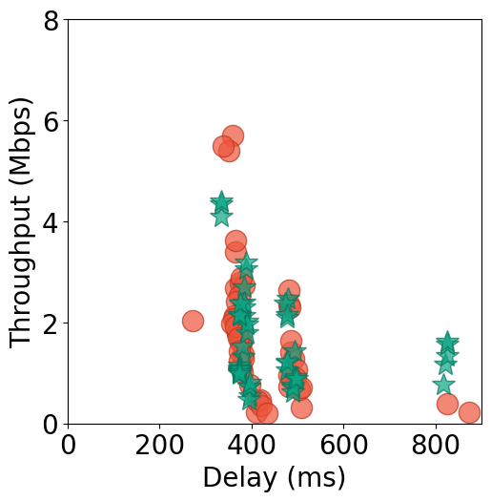
Evaluation: Overall
Methodology: train on protocol A (TCP Cubic), test on unseen protocol B (TCP BBR)
End-to-end results of Protocol B (TCP BBR) on China Cellular dataset
No cross-traffic
Non-reactive cross-traffic
Reactive cross-traffic
Progressively better match →
Notes:
For overall evaluation of iBox, we bring the static parameters and cross-traffic model together and wire up a simulation using these parameters. We deploy an unseen protocol as the sender and compare its performance with the available GT performance.
(click) In the example that will follow, we trained iBox on cubic traces from the China cellular dataset and inferred the performance of BBR using the trained iBox model. We then compared the iBox inference for BBR with the available GT for BBR. (click) The orange dots in the throughput vs delay plot indicate the GT, where each dot corresponds to a single TCP transfer. The green dots represent the iBox inference for BBR. As we progress from No CT model, (click) to NRCT and then to a (click) RCT model, we progressively get a better match wrt GT.

Slide 24
Challenges / future opportunities
Extending simplified network model
  Lack of generalization to unmodelled behaviors
  e.g., ISP policing, bursty loss
Using protocols other than Cubic for estimation
  What can be learnt from other protocols?
Selective active probing to better estimate network parameters
  Combination of passive and active probing to minimize disruptions to running services
Bayesian optimization to fine-tune static parameters as well
  Joint optimization of static as well as dynamic parameters
Notes:
There are several challenges and future opportunities in this space.
(click)
The current iBox model is simple and does not generalize to unmodelled behaviors such as ISP policing, variable bandwidth, burst loss.
(click)
The current model is trained on TCP Cubic which is an aggressive protocols and explores the network limits. What can be estimated from other protocols is an interesting question to explore.
(click) Selective active probing and using (click) Bayesian optimization to get better estimates of network parameters is also an interesting research direction.

Slide 25
Conclusion
We’ve presented iBox, a data-driven network path simulator which
  Learns from real-world data
  Recreates realistic scenarios for testing
  Replicates real-world performance of protocols in simulation
Using data to create realism is an exciting direction but a lot of open challenges remain!
iBox models are available for public download. Please check out the project website (aka.ms/ibox) for more details!
Questions?
Notes:
To conclude, (click) iBox is a data-driven network path simulator (click) that learns from real world data and (click) faithfully replicates real world performance of protocols in (click) simulation.
(click)
Using data to create realism is a promising research direction with a lot of open challenges.
(click)
The iBox models are available for public download. Visit aka.ms/ibox for details.
Thank you!

Slide 26
Back up

Slide 27
2nd half flow
Evaluation
  Setup
  Dataset: pantheon
  What are we evaluating?
    Static, NRCT, RCT, Overall evaluation
    For purposes of this talk, I will focus only on NRCT, RCT, and overall evaluation
  NRCT evaluation
    Simulation, real-world
  RCT evaluation
    Simulation: to give a flavor of how RCT works, here are two sample results: one good and one decent
  Overall evaluation
    Evaluation methodology: train on A, test on B
    Putting everything together, we test how well we’re able to predict the real-world performance of an application
    First, results on A
    Then, results on B even though B’s data was never used for training
Challenges and opportunities
Summary

Slide 28
Reactive Cross Traffic (RCT)
Example plot

Slide 29
Non-Reactive Cross Traffic (NRCT)
Why does it matter?

Slide 30
Reactive Cross Traffic (RCT)
Idea: Model cross-traffic as a set of reactive TCP flows → Reactive Cross Traffic (RCT)
<Cubic, start: 3s, end: 10s>
<Vegas, start: 5s, end: 15s>
We use Bayesian Optimization-based search to look for the start and stop times of these flows
Cubic
t=0
t=3s
t=5s
t=10s
t=15s
t=20s
Vegas
Notes:
So in order to make our cross traffic reactive, we model cross traffic as a set of real, reactive TCP flows which we call reactive cross traffic or RCT.
So for example, instead of a static time series, it would look something like this.
Here in this example, the cross traffic consists of two flows, one running Cubic which starts at 3s and ends at 10s and the other runs vegas which starts at 5 and ends at 15 seconds as illustrated here.
Instead of using any sophisticated formulation, we use bayesian optimization based search to look for the start and stop times as well as the nature of these flo

Slide 31

Promising use-case: A/B testing
Slow
Error-prone
Expensive
Version A
Version A
Process logs
Compare A and B
Fine-tune version B
Version A
Version A
Version A
Version B
New Feature
Version B
logs
Notes:
One of the most promising use-cases for this work is to help in A/B testing of a product.
Imagine this scenario where you have a production system serving many clients.
In A/B testing, when developers implement a new feature, they roll it out to small percentage of clients like version B as shown here.
Once it is operational, they collect traces corresponding to version B.
They process these logs, compare the performance of A and B and fine-tune B based off their observations. In cases where B works well, they might roll it out to the entire cluster.
The problem with this approach is that it is slow because iterations take too long, it is error-prone as version B could contain bugs which would result in bad service, and it is expensive since bad service and performance regressions can cause customers to drop their product altogether.

Slide 32
Promising use-case: A/B testing
Fast
Safe
Cheap
Version A
Version A
Version A
Process logs
Compare A and B
Fine-tune version B
If good enough, push
Version B
Version A
Version A
iBox Network Path Simulator
Version B
logs
Version A
Version B
New Feature
New Feature
Notes:
If iBox were to be used in this scenario, when developers implement a new feature, they push it out first to iBox and collect the logs corresponding to version B.
Now, like in the previous scenario, they process these logs, compare A and B, and fine-tune B.
Now crucially, if these results look good enough, they will push these changes to the production system.
This would enable the feature development cycle to be fast since we're using simulations, safe from regressions as iBox is able to detect regressions before they go to production and cheap as customers are not exposed to defective features.

Slide 33
Promising use-case: A/B testing
Teams
Zoom
xCloud
…
✓ Speed up iterations
✓ Avoid regressions
✓ Reduce overhead
Flighting
TCP BBR
TCP Cubic
SILK codec
…
Offline
iBox
Flighting
Testing
ML-based CC
…
Notes:
Animate better
Finish the story

Slide 34

Introducing “Internet in a Box”
Primary use-case: A/B testing
Version A
Version A
Version B
Version A
Version A
New Feature
Notes:
Animate better
Finish the story

Slide 35



iBox
Client
Server
Action
Rate
RL
Time
Reward, State

Slide 36
Problem
Experimentation on a real network is expensive and disruptive whereas simulation on the other hand can be cheap and easy to use.
But it is often unrealistic and not representative …
… which leads to inaccurate and over-promising results
Notes:
Animate
Provide examples

Slide 37



Implementation
Simulation
Emulation
NetEm
2-dumbbell topology
Bottleneck bandwidth
Link delay
Buffer size
Cross-Traffic
Bottleneck bandwidth
Link delay
Buffer size
Cross-Traffic
C
C
NetEm link
R
S
R
S
Simulated devices
Real/emulated devices

Slide 38
iBox: Internet in a Box
Non-reactive cross-traffic (NRCT):
  C_{est} = {Q(k) – Q(k - n) + drainTime * b – ∑s_{i}} / ∑τ_{i}
  Q(k) = queue occupancy estimated at the kth packet
  drainTime: duration when we’re sure buffer was draining at bottleneck bandwidth
    ⇒ conservative estimate of C
  ∑τi: Sum of all inter packet times in window
  ∑si: Sum of all packet sizes in window
Δt
Inflow = Observed volume + cross-traffic volume
Observed volume = ∑s_{i}
cross-traffic volume = C_{est}. Δt
Outflow = b* Δt
Inflow = outflow + ΔQ
Notes:
Use previous diagram in overview
Explain formula intuitively

Slide 39
Outline
Why is simulation useful? What are their limitations?
Current state of network simulation
Internet in a Box
  Overview: inputs and outputs
  Primary use-case: A/B testing
iBox
  Basic parameters
    Data collection and the choice of protocol for training
  NRCT
    NRCT formula
    Estimation results in simulation
    Improvement in results
  RCT
    Bayesian Optimization pipeline
    Show 1 RCT iteration
    Improvement in results
Implementation
Evaluation
    Dataset: Pantheon
    Metrics: rate, delay, loss, wasserstein etc.
    Evaluation methodology: train → test
    Overall results
Challenges and future opportunities
Summary
  Contributions
  Open source
      Dataset
      Code

Slide 40
iBox: Internet in a Box
Non-reactive cross-traffic (NRCT):
Observed flow
S
R
Queue Draining at Peak Bandwidth (b)
Δt
Inflow = Observed volume + cross-traffic volume
Observed volume = ∑s_{i}
cross-traffic volume = C_{est}. Δt
Outflow = b* Δt
Inflow = outflow + ΔQ
Cross Traffic
Notes:
Use previous diagram in overview
Explain formula intuitively

Slide 41
iBox: Internet in a Box
Non-reactive cross-traffic (NRCT):
Δt
Inflow = Observed volume + cross-traffic volume
Observed volume = ∑s_{i}
cross-traffic volume = C_{est}. Δt
Outflow = b* Δt
Inflow = outflow + ΔQ
Notes:
Use previous diagram in overview
Explain formula intuitively

Slide 42
iBox: Basic Parameters
Estimation of basic parameters:
  b (bottleneck bandwidth) based on peak receiving rate seen in the trace
  d (propagation delay) based on minimum delay experienced by packets in the trace
  B (buffer size) based on b and the difference between the min and max delays (max queueing delay)
Unlike online estimation (e.g., for congestion control) where estimates become more accurate over time, in the offline scenario, the entire trace is available offline for estimation
We also combine information from multiple flows on same day to get better estimates
Notes:
At a high level, the basic parameters are estimated as follows
The bottleneck bandwidth b is based off the peak receiving rate seen in the trace.
The propagation delay d is based on the minimum delay experienced by packets in the trace
And the buffer size B is based on the bottleneck bandwidth and the difference between the min and the max delay faced by packets in the trace.
A key point to keep in mind is that unlike in online estimation where estimates become more accurate over time as more, in the offline scenario, the entire trace is available for estimation
XXX
At the end we just say that we will shortly see why it is imperative to model cross-traffic.
Explanations
1. Buffer size: cubic can estimate max buffer very well since it fills up buffers
2. Bottleneck bandwidth: depends on other flows
3. Prop delay: depends on min buffer
a. Cubic is explorative
b. We look at multiple traces from the same path
c. Basic estimates and we build on top of this

Slide 43
Evaluation
Basic parameters
NRCT
  Controlled setting: normalized error between GT and NRCT
  Real world traces: additional cross-traffic estimated, underestimation error
RCT:
  Example plots showing results of BO
Overall:
  Throughput vs delay plots (NoCT → NRCT -> RCT)

Slide 44
Evaluation: Overall
Methodology: train on protocol A, test on unseen protocol B
End-to-end results of TCP BBR on China Cellular dataset
End-to-end results of TCP BBR on China Cellular dataset
No cross-traffic
Non-reactive cross-traffic
Reactive cross-traffic
Progressively better match →
Notes:
For overall evaluation of iBox, we put together the static parameters and the cross-traffic model, to see how well iBox can test network protocols. (click) We train iBox model on a protocol A and test it on an unseen protocol B. (click) In the current example, we trained iBox on cubic traces from the China cellular dataset and tested them on BBR traces from the same dataset. (click) The orange dots in the throughput vs delay plot indicate the GT, where each dot corresponds to a single TCP transfer. The green dots represent the iBox inference for BBR. As we progress from No CT model, (click) to NRCT and then to a (click) RCT model, we progressively get a better match wrt GT.

Slide 45
Evaluation: NRCT (real world)
Metrics:
  Underestimation error (lower bound violation error)
  Additional CT estimated (cross-traffic rate exceed beyond lower bound)
Notes:
In traces coming from real world networks, the GT cross-traffic is not observed making it tough to evaluate NRCT in a real world setting.
One idea is to is to run concurrent connections on a real network path, pick one flow as the observation flow and treat rest as the cross-traffic flow.
(click)
We use two evaluation metrics: (click) the underestimation error and (click) additional CT estimated. Lets take an example to understand these metrics. (click) We choose a trace with 3 concurrent flows and pick flow 1 as the observed flow and flows 2 and 3 as the CT flows. The yellow curve in the plot shows the known ct. (click) The blue curve shows the NRCT estimated using the observed flow 1. The addition cross-traffic estimated is the volume of cross-traffic estimate that exceeds the known lower bound (click) (which is shown as blue dotted area in the plot). (click) The region where the NRCT estimate violates the known lower bound is marked by the red dotted line. Such regions represent the underestimation error.
(click)
The plot on the right, shows the CDF of underestimation error. The underestimation error is quite small, that is under 2% in over 90% of the cases. The additional CT is under 250% in 90% of the cases.

